Slide 1
Chapter 17
Swing Fundamentals
Copyright © 2013 by The McGraw-Hill Companies, Inc. All rights reserved.

Slide 2
Swing Fundamentals
Swing is a collection of classes and interfaces that offer a rich set of visual components.
Swing components are lightweight—they are written entirely in Java.
As such, they can have a variety of look-and-feels.
Copyright © 2013 by The McGraw-Hill Companies, Inc. All rights reserved.

Slide 3
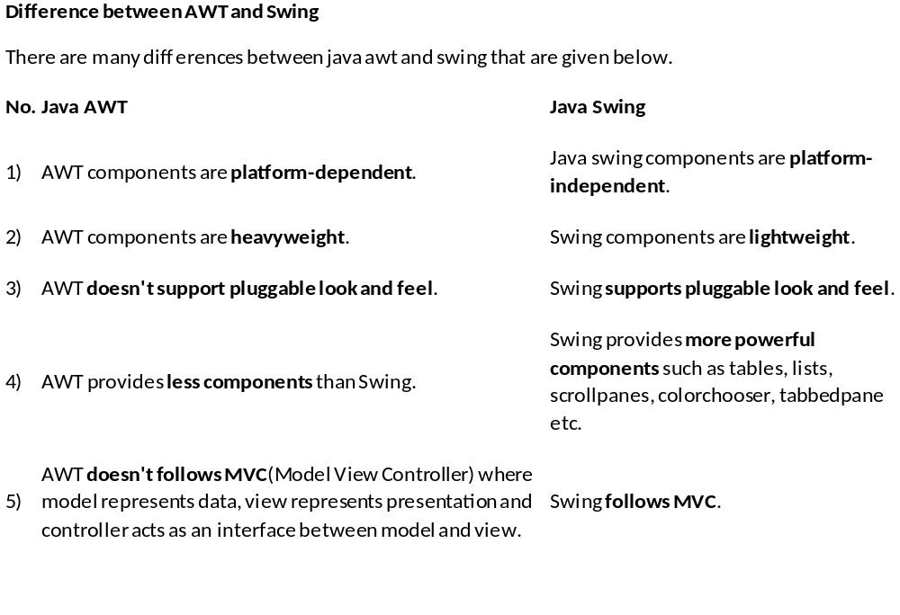

Slide 4
Swing components are lightweight:
This means that they are written entirely in Java and do not map directly to platform-specific peers.
lightweight components are more efficient and more flexible.
Swing components provide pluggable look and feel:
because lightweight components do not translate into native peers, the look and feel of each component is determined by Swing, not by the underlying operating system.

Slide 5
Model-View-Controller (MVC)
model—corresponds to state information of a component
For example, in a check box model contains a field indicating checked/unchecked.
view—determines how the component is displayed on the screen
controller—determines how the component reacts to the user
For example when user clicks on check box , the controller reacts by changing the model to reflect the user choice
Swing uses a modified version of MVC that combines the view and controller.
Copyright © 2013 by The McGraw-Hill Companies, Inc. All rights reserved.

Slide 6
Components
Swing consists of two key items: components and containers.
The JComponent class is the superclass of all but four Swing components.
All Swing components are in the javax.swing package.
There are currently 46 Swing components, including JButton, JDialog, JCheckBox, JMenu, and JMenuItem.
Copyright © 2013 by The McGraw-Hill Companies, Inc. All rights reserved.

Slide 7
Containers
Top-level containers in Swing: JFrame, JApplet, JWindow, JDialog.
These do not inherit from JComponent.
Top-level containers cannot be contained in another container.
Top-level containers contain several components called panes.
The content pane holds the components the user interacts with.
Copyright © 2013 by The McGraw-Hill Companies, Inc. All rights reserved.

Slide 8
Layout Managers
Layout managers control the position of components within a container.
Layout managers implement the LayoutManager interface.
Two of the layout managers are:
  FlowLayout—A simple layout that positions components left-to-right, top-to-bottom.
  BorderLayout—Positions components within the center or on the borders of the container. This is the default layout for a content pane.
Copyright © 2013 by The McGraw-Hill Companies, Inc. All rights reserved.

Slide 9
Simple Swing Demo
import javax.swing.*;
class SwingDemo {
SwingDemo() {
JFrame jfrm = new JFrame("A Simple Swing App");
jfrm.setSize(275, 100);
jfrm.setDefaultCloseOperation(JFrame.EXIT_ON_CLOSE);
JLabel jlab = new JLabel(" Swing: the Java GUI.");
jfrm.add(jlab);
jfrm.setVisible(true);
}
public static void main(String[] args) {
SwingUtilities.invokeLater(new Runnable() {
public void run() { new SwingDemo(); }
});
}
}
Copyright © 2013 by The McGraw-Hill Companies, Inc. All rights reserved.

Slide 10
Event Dispatching Thread
Swing applications are event driven.
Swing provides an event-dispatching thread to handle events, separate from the main thread.
All Swing GUI components must be created and updated on the event-dispatching thread.
In the SwingDemo class, the call to SwingUtilities.invokeLater( ) causes the Runnable code to be executed on the event-dispatching thread.
Copyright © 2013 by The McGraw-Hill Companies, Inc. All rights reserved.

Slide 11
Event Handling
Event handling is a large part of any Swing-based application.
Events are generated when, for example, the user clicks a button, types a key, or selects an item from a list.
In Swing, a source generates an event and sends it to one or more listeners.
Listeners just wait until they receive events, and then they process the events.
Copyright © 2013 by The McGraw-Hill Companies, Inc. All rights reserved.

Slide 12
Event Handling (continued)
This approach is called the delegation event model since the GUI element delegates the processing of the event to a separate object.
All listeners must register with the source if they wish to be notified of events.
This is essentially the Observer pattern described in Chapter 16.
Copyright © 2013 by The McGraw-Hill Companies, Inc. All rights reserved.

Slide 13
Event Sources
Event sources have methods of the form:
  public void addTypeListener(TypeListener el)
  public void removeTypeListener(TypeListener el)
These methods are called to add or remove listeners from the notification list.
Example:
JButton b = new JButton();
ActionListener el = new ActionListener(){ ... }
b.addActionListener(el);
Copyright © 2013 by The McGraw-Hill Companies, Inc. All rights reserved.

Slide 14
Event Listeners
Listeners are notified when events occur.
They have two requirements:
  They must register with a source.
  They must implement a method to receive and process the event.
The methods they implement are defined by interfaces.
The methods must quickly process the event and return or else use a separate thread, to avoid tying up the event-dispatching thread.
Copyright © 2013 by The McGraw-Hill Companies, Inc. All rights reserved.

Slide 15
Some Event Classes
Event Class | Description | Event Listener
ActionEvent | Generated when an action occurs within a control, such as when a button is pressed. | ActionListener
FocusEvent | Generated when a component gains or loses focus. | FocusListener
ItemEvent | Generated when an item is selected, such as when a check box is clicked. | ItemListener
KeyEvent | Generated when input is received from the keyboard. | KeyListener
MouseEvent | Generated when the mouse is dragged, moved, clicked, pressed, or released; also generated when the mouse enters or exits a component. | MouseListener and MouseMotionListener
Copyright © 2013 by The McGraw-Hill Companies, Inc. All rights reserved.

Slide 16
Adapter Classes
Adapter classes provide empty implementations of event listener interface methods.
You can extend one and implement only those methods in which you are interested.
Sample adapter classes:
Adapter Class | Implements
KeyAdapter | KeyListener
MouseAdapter | MouseListener
MouseMotionAdapter | MouseMotionListener
Copyright © 2013 by The McGraw-Hill Companies, Inc. All rights reserved.

Slide 17
Using a Push Button
A push button is an instance of JButton.
A push button generates an ActionEvent.
The associated listener interface is ActionListener, which has one method:
  public void actionPerformed(ActionEvent ae)
In summary, to handle a button press event,
  Create a class that implements ActionListener.
  Register the class with the JButton by calling the button's addActionListener( ) method.
Copyright © 2013 by The McGraw-Hill Companies, Inc. All rights reserved.

Slide 18
Using a Push Button (continued)
When the user presses the JButton, it generates an ActionEvent.
All registered listeners are notified; more precisely their actionPerformed( ) methods are called.
The ActionEvent is passed as the argument to the actionPerformed( ) method.
ActionEvent class has several methods to give you more information about the event.
Copyright © 2013 by The McGraw-Hill Companies, Inc. All rights reserved.

Slide 19
Push Button Example
class ButtonHandler implements ActionListener {
public void actionPerformed(ActionEvent ae) {
label.setText(ae.getActionCommand());
}
}
...
JButton button = new JButton("First");
ButtonHandler handler = new ButtonHandler();
button.addActionListener(handler);
...
// when the button is pushed, the word "First" is
// displayed as the text in a label.
Copyright © 2013 by The McGraw-Hill Companies, Inc. All rights reserved.

Slide 20
Introducing JTextFields
A JTextField control enables the user to enter a line of text.
If the user presses ENTER when inputting into a text field, an ActionEvent is generated.
Listeners must implement the ActionListener interface.
Copyright © 2013 by The McGraw-Hill Companies, Inc. All rights reserved.

Slide 21
Introducing JTextFields (continued)
One of its constructors:
  JTextField(int cols)
It creates a text field with the given width.
The JTextField class has methods for accessing the text that the field displays:
  void setText(String text)
  String getText( )
Copyright © 2013 by The McGraw-Hill Companies, Inc. All rights reserved.

Slide 22
JTextField Example
class TextFieldHandler implements ActionListener {
public void actionPerformed(ActionEvent ae) {
label.setText(ae.getActionCommand());
}
}
...
JTextField field = new JTextField(10);
TextFieldHandler handler = new TextFieldHandler();
field.addActionListener(handler);
...
// when ENTER is pressed, the contents of the text
// field are displayed in a label.
Copyright © 2013 by The McGraw-Hill Companies, Inc. All rights reserved.

Slide 23
Using Anonymous Inner Classes
Here are some ways to handle events:
  Have the class with the main method be the listener.
  Create a separate listener class.
  Use an anonymous inner class as the listener.
Example of the third way:
button.addActionListener(new ActionListener() {
public void actionPerformed(ActionEvent ae) {
label.setText(ae.getActionCommand());
}
});
Copyright © 2013 by The McGraw-Hill Companies, Inc. All rights reserved.

